Slide 1
Machine Learning 101
Pierre Ghesquière, Dipl.Ing.-M.Sc. (c)
Research Skills Transfer Workshops

Slide 2
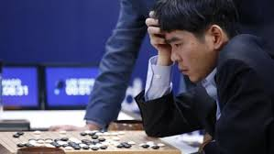
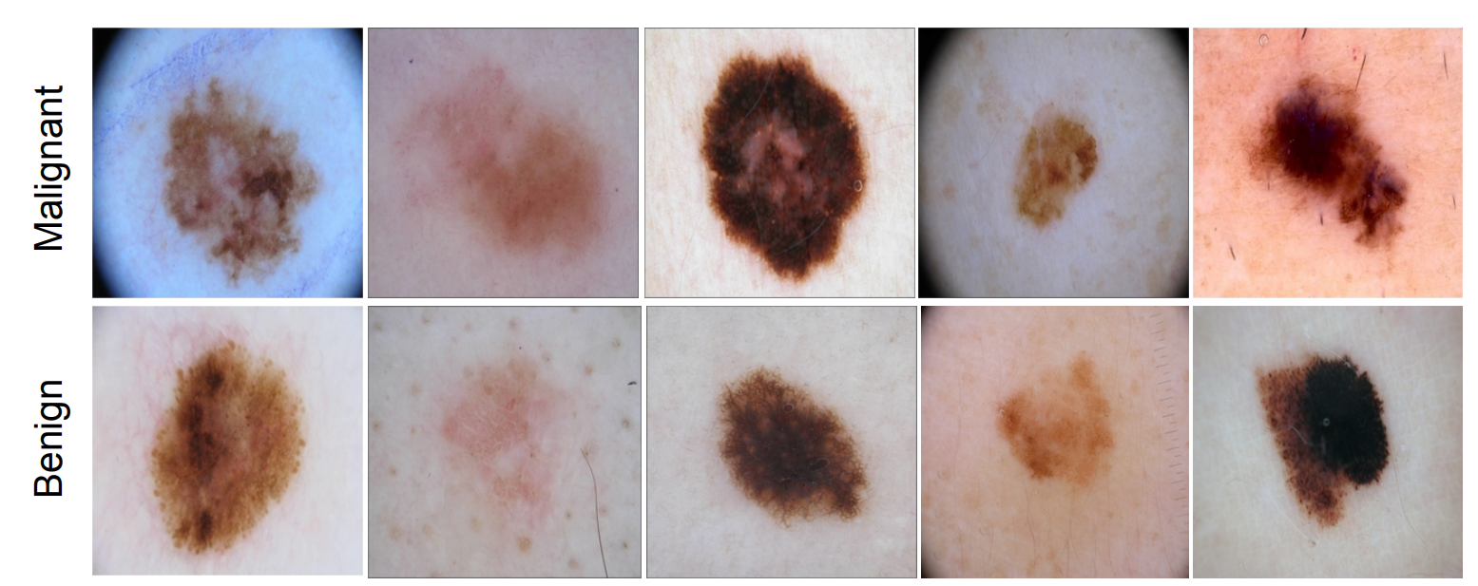
Purpose of this workshop
Machine Learning is a topic becoming more and more important today. But it remains confusing for most people.
Alpha Go vs Lee Sedol (March 2016)
Dermoscopic Melanoma Recognition
(Annals of Oncology, May 2018)
Machine learning is simple (much more simple than immunology…) !
Be able to understand a paper, a talk about machine learning

Slide 3
Presentation Outline
1- Introduction
- Definition of Machine Learning
- A simple example
2- Methodology of Machine Learning
- General Methodology
- 2 Algorithms very popular : Random Forest and Neural Network
3- Examples applied in Medicine : Disease Detection
4- Conclusion
- Synthesis
- Limits of Machine Learning

Slide 4
Introduction
Definition :
A Machine Learning algorithm is an algorithm capable of automatically recognizing different objects.
To do so, the algorithm had observed lots of examples of those objects to build its own classification model.

Slide 5
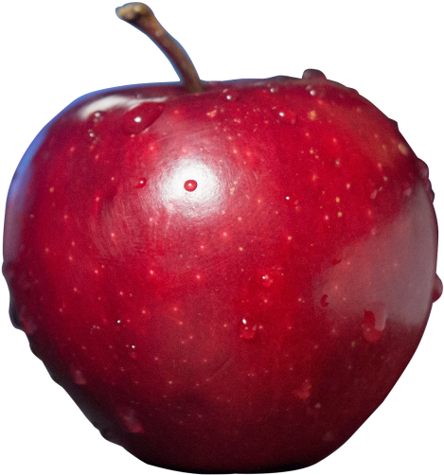
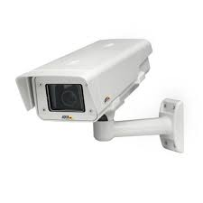

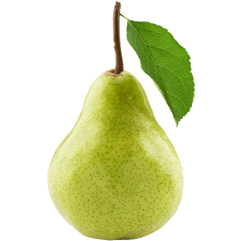
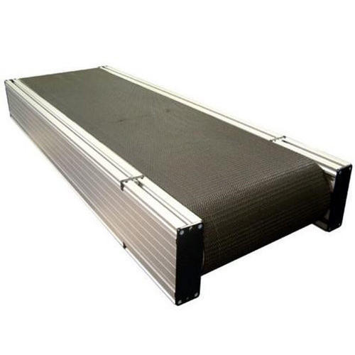

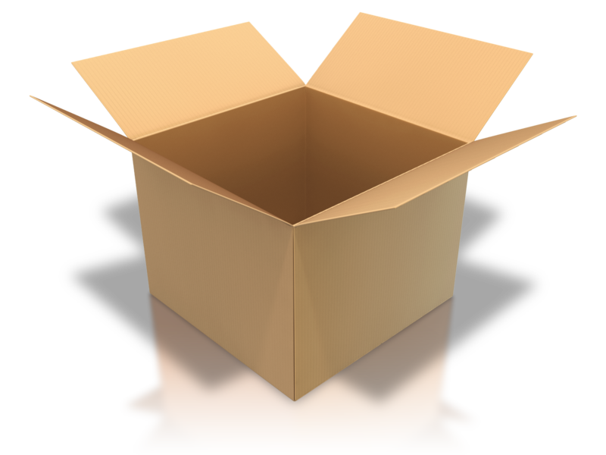
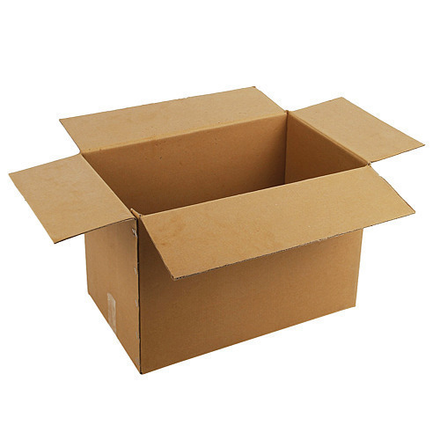

Introduction : Starting example
Apple or Pear ?
It’s an apple
PEAR BOX
Definition.
-A Machine Learning algorithm is an algorithm capable of automatically recognizing different objects.
APPLE BOX
-To do so, the algorithm had observed lots of examples of those objects to build its own classification model.

Slide 6
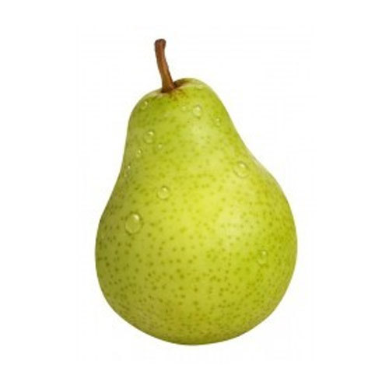
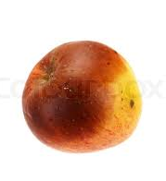
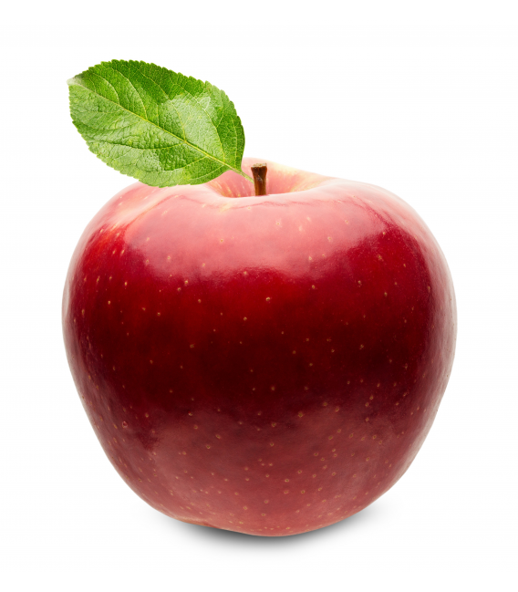
Introduction : Starting example
PEAR BOX
Definition.
-A Machine Learning algorithm is an algorithm capable of automatically recognizing different objects.
APPLE BOX
-To do so, the algorithm had observed lots of examples of those objects to build its own classification model.

Slide 7
Introduction : Starting example
PEAR BOX
Definition.
-A Machine Learning algorithm is an algorithm capable of automatically recognizing different objects.
APPLE BOX
-To do so, the algorithm had observed lots of examples of those objects to build its own classification model.

Slide 8
Introduction : Starting example
h
h
PEAR BOX
L
L
Definition.
-A Machine Learning algorithm is an algorithm capable of automatically recognizing different objects.
APPLE BOX
-To do so, the algorithm had observed lots of examples of those objects to build its own classification model.

Slide 9
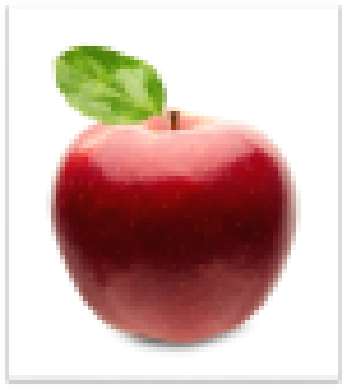
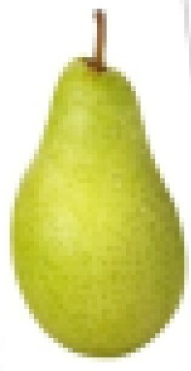

Introduction : Starting example
color :
color :
PEAR BOX
Definition.
-A Machine Learning algorithm is an algorithm capable of automatically recognizing different objects.
APPLE BOX
-To do so, the algorithm had observed lots of examples of those objects to build its own classification model.

Slide 10
Introduction : Starting example
PEAR BOX
Definition.
-A Machine Learning algorithm is an algorithm capable of automatically recognizing different objects.
APPLE BOX
-To do so, the algorithm had observed lots of examples of those objects to build its own classification model.

Slide 11
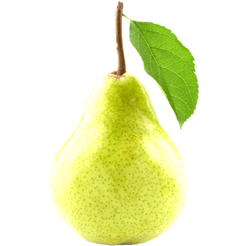

Introduction : Starting example
Elongation
$$\frac{h}{L}$$
2
1
0
Color
1
PEAR BOX
Definition.
-A Machine Learning algorithm is an algorithm capable of automatically recognizing different objects.
APPLE BOX
-To do so, the algorithm had observed lots of examples of those objects to builds its own classification model.

Slide 12
Presentation Outline
1- Introduction
- Definition of Machine Learning
- A simple example
2- Methodology of Machine Learning
- General Methodology
- 2 Algorithms very popular : Random Forest and Neural Network
3- Examples applied in Medicine : Disease Detection
4- Conclusion
- Synthesis
- Limits of Machine Learning

Slide 13
Methodology : Generalities
2 Steps :
Building of a representation
Building of a model
Elongation
Model
Color
2D representation of apple and pears

Slide 14
Methodology : Generalities
Building of a representation
Building of a model
Elongation
Model
Color

Slide 15
Methodology : Generalities
Building of a representation
1-Feature Extraction
2-Feature Selection

Slide 16
Methodology : Generalities
Building of a representation
1-Feature Extraction
2-Feature Selection
Elongation
Color
Elongation
$$\frac{h}{L}$$
Object 1 :
0.2 | 2.02
0.89 | 0.95
0.89 | 0.99
… | …
0.23 | 1.90
2
Object 2 :
Object 3 :
1
…
Object N :
1
0
Color
X : Feature Matrix (N, 2)

Slide 17
Methodology : Generalities
Building of a representation
1-Feature Extraction
2-Feature Selection
Elongation
Color
Weight
Elongation
$$\frac{h}{L}$$
Object 1 :
0.2 | 2.02
0.89 | 0.95
0.89 | 0.99
… | …
0.23 | 1.90
0.51
0.48
0.62
…
0.35
2
Object 2 :
Object 3 :
1
…
Object N :
1
0
Color
X : Feature Matrix (N, 2)
X : Feature Matrix (N, 3)

Slide 18
Methodology : Generalities
Building of a representation
1-Feature Extraction
2-Feature Selection
Geographic
Origin
Elongation
Elongation
Roughness
Feature F
Color
Weight
. . .
Object 1 :
0.2 | 2.02
0.89 | 0.95
0.89 | 0.99
… | …
0.23 | 1.90
0.51
0.48
0.62
…
0.35
0.01
0.02
0.02
…
0.01
USA
Queb.
USA
…
USA
0.28
0.32
0.25
…
0.85
. . .
Object 2 :
. . .
Object 3 :
…
. . .
. . .
Object N :
Color
Weight
X : Feature Matrix (N, F)

Slide 19
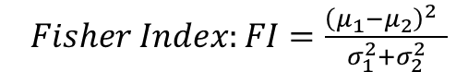
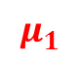
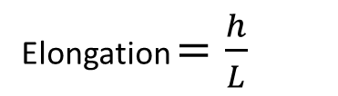
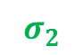
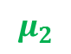
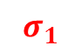
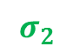
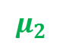
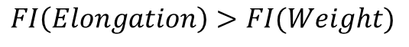

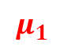
Methodology : Generalities
Geographic
Origin
Elongation
Roughness
Feature F
Building of a representation
Color
Weight
. . .
Object 1 :
0.21 | 2.02 | 0.51
0.82 | 0.95 | 0.48
0.85 | 0.99 | 0.62
… | … | …
0.23 | 1.90 | 0.35
0.01
0.02
0.02
…
0.01
USA
Queb.
USA
…
USA
0.28
0.32
0.25
…
0.85
. . .
1-Feature Extraction
2-Feature Selection
Object 2 :
. . .
Object 3 :
…
. . .
. . .
Object N :
Elongation $=\frac{h}{L}$
$$μ_{1}$$
$$μ_{2}$$
X : Feature Matrix dimension (N, F)
$$σ_{1}$$
$$σ_{2}$$
$Fisher Index:FI=\frac{{\left(μ_{1}−μ_{2}\right)}^{2} }{σ_{1}^{2}+σ_{2}^{2}}$
Weight :
$$μ_{1}$$
$$μ_{2}$$
$$FI\left(Elongation\right)>FI(Weight)$$
0.3
0.4
0.5
0.6
0.7
(kg)
$$σ_{1}$$
$$σ_{2}$$

Slide 20
Methodology : Generalities
Building of a representation
Building of a model
Building of a representation
Building of a model
Shape
Feature F
Color
. . .
Object 1 :
0.21 | 2.02
0.82 | 0.95
0.85 | 0.99
… | …
0.23 | 1.90
0.28
0.32
0.25
…
0.85
. . .
Object 2 :
. . .
Object 3 :
…
. . .
. . .
Object N :
X : Feature Matrix dimension (N, F)

Slide 21
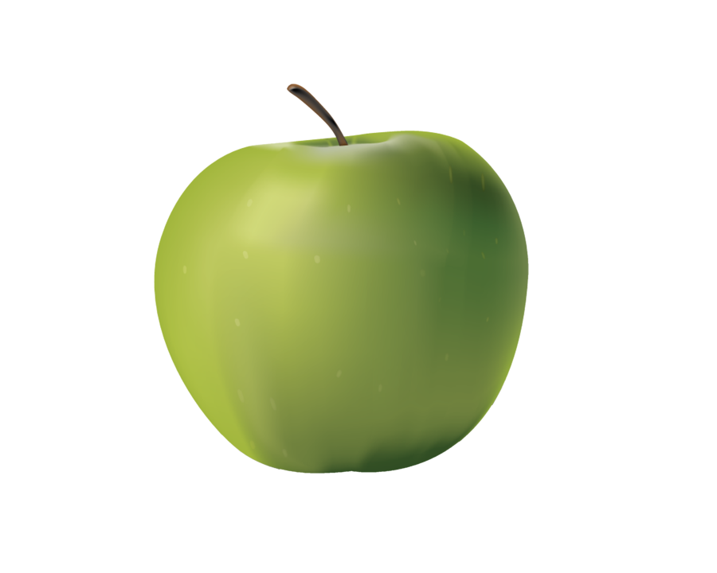
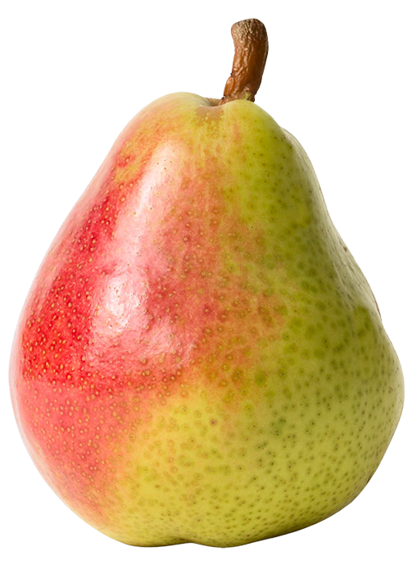
Methodology : Generalities
Building of a model

Slide 22
Methodology : Generalities
Building of a model
Apple
Apple
Apple
Apple
Pear
Pear
Pear
Pear
Pear
Apple
Pear
Apple
Apple
Apple
Pear
Pear

Slide 23
Methodology : Generalities
Building of a model
1- Divide the database in 2 sets
(75-80%)
Training set
Test set
(20-25%)

Slide 24
Methodology : Generalities
Building of a model
1- Divide the database in 2 sets
Training set
Test set
2- Training :
Feature 2
Feature 1

Slide 25
Methodology : Generalities
Building of a model
1- Divide the database in 2 sets
Training set
Test set
2- Training :
Feature 2
Feature 1

Slide 26
Methodology : Generalities
Building of a model
1- Divide the database in 2 sets
Training set
Test set
2- Training :
Feature 2
Feature 1

Slide 27
Methodology : Generalities
Building of a model
?
1- Divide the database in 2 sets
?
?
?
Training set
Test set
2- Training :
Feature 2
Pear
Apple
3- Testing
= We test the performances of our model on the test set
Feature 1

Slide 28
Methodology : Generalities
Building of a model
1- Divide the database in 2 sets
?
?
?
Training set
Test set
2- Training :
Feature 2
Pear
Apple
3- Testing
Apple
= We test the performances of our model on the test set
Feature 1

Slide 29
Methodology : Generalities
Building of a model
1- Divide the database in 2 sets
?
?
?
Training set
Test set
2- Training :
Feature 2
= automatically build the model on the training set
Pear
Apple
3- Testing
Apple
= We test the performances of our model on the test set
Feature 1

Slide 30
Methodology : Generalities
Building of a model
Apple
1- Divide the database in 2 sets
?
?
?
Training set
Test set
2- Training :
Feature 2
= automatically build the model on the training set
Pear
Apple
3- Testing
= We test the performances of our model on the test set
Feature 1

Slide 31
Methodology : Generalities
Building of a model
Apple
1- Divide the database in 2 sets
?
?
Training set
Test set
2- Training :
Feature 2
Pear
Pear
Apple
3- Testing
= We test the performances of our model on the test set
Feature 1

Slide 32
Methodology : Generalities
Building of a model
Apple
1- Divide the database in 2 sets
Pear
?
?
Apple
?
Training set
Test set
2- Training :
Feature 2
Precision : 75%
Pear
Apple
3- Testing
= We test the performances of our model on the test set
Feature 1

Slide 33
Methodology : Generalities
Building of a model
Apple
1- Divide the database in 2 sets
Pear
?
?
Apple
Training set
Test set
2- Training :
Feature 2
Precision : 75%
Pear
Apple
Apple
3- Testing
= We test the performance of our model on the test set
Feature 1

Slide 34
Methodology : Generalities
Building of a model
Apple
1- Divide the database in 2 sets
Apple
?
?
Apple
?
Apple
Training set
Test set
2- Training :
Feature 2
Precision : 75%
3- Testing
= We test the performances of our model on the test set
Feature 1

Slide 35
Methodology : Generalities
Building of a model
Apple
1- Divide the database in 2 sets
Apple
?
?
Apple
?
Apple
Training set
Test set
2- Training :
Feature 2
Precision : 75%
3- Testing
= We test the performances of our model on the test set
Feature 1

Slide 36
Methodology : Generalities
Building of a model
Apple
1- Divide the database in 2 sets
Apple
?
?
Apple
?
Apple
Training set
Test set
2- Training :
Feature 2
➔ Overfitting
Precision : 75%
3- Testing
= We test the performances of our model on the test set
Feature 1

Slide 37
Methodology : Generalities
Building of a model
Apple
1- Divide the database in 2 sets
Apple
?
?
Apple
?
Apple
Training set
Test set
2- Training :
Feature 2
Precision on training set : 100%
3- Testing
= We test the performances of our model on the test set
Feature 1

Slide 38
Methodology : Generalities
Building of a model
Apple
1- Divide the database in 2 sets
Apple
?
?
Apple
?
Apple
Training set
Test set
2- Training :
Feature 2
Precision on training set : 100%
on test set : 50%
➔ Overfitting : The model is too specific to the training set and can’t be generalised to the test set.
3- Testing
= We test the performances of our model on the test set
Feature 1

Slide 39
Presentation Outline
1- Introduction
- Definition of Machine Learning
- A simple example
2- Methodology of Machine Learning
- General Methodology
- 2 Algorithms very popular : Random Forest and Neural Network
3- Examples applied in Medicine : Disease Detection
4- Conclusion
- Synthesis
- Limits of Machine Learning

Slide 40
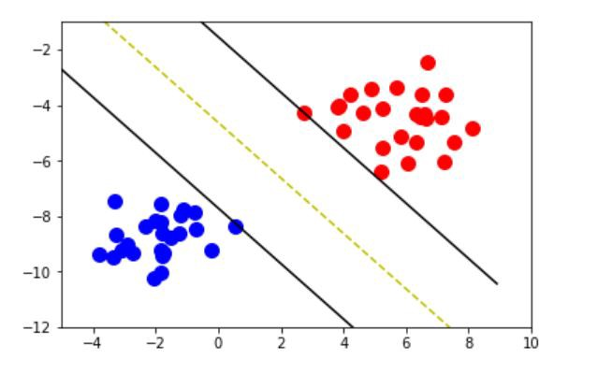
Méthodology : 2 classifiers
Lots of classifiers :
Support Vector Machine (SVM)
K-nearest neighbour
Random Forest
Neural Network
…
Feature 2
Feature 1
Support Vector Machine (SVM)
K-nearest neighbour

Slide 41
Méthodology : 2 classifiers
Lots of classifiers :
Support Vector Machine (SVM)
K-nearest neighbour
Random Forest
Neural Network
…
Feature 2
Feature 1
Support Vector Machine (SVM)
K-nearest neighbour

Slide 42
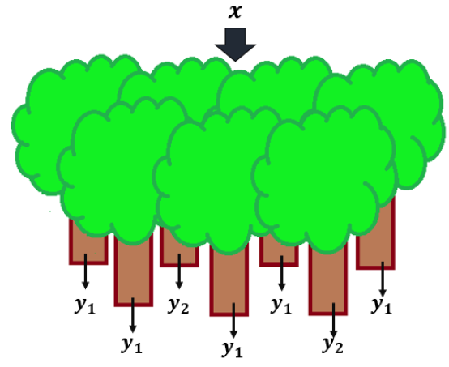
Méthodology : Random Forest
Elongation
Roughness
Color
Weight
Example of decision tree
d₁ | d₂ | … | d_{F}
d₁ | d₂ | … | d_{F}
If d₈₃<2.2
else
d₆₁₈<0.5
else
If d₂₄₅<3.4
else
d₃₄₁<100
else
apple
pear
d₇₁₅<0.3
else
apple
apple
apple
apple
apple
pear
apple
pear
pear
pear
apple
pear
apple
How to automatically build a decision tree from the observation of examples ?

Slide 43
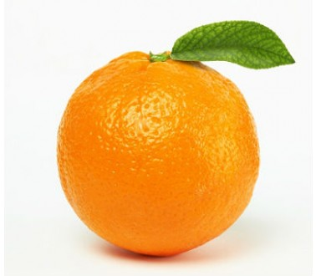
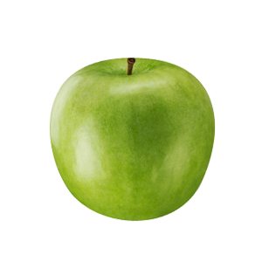
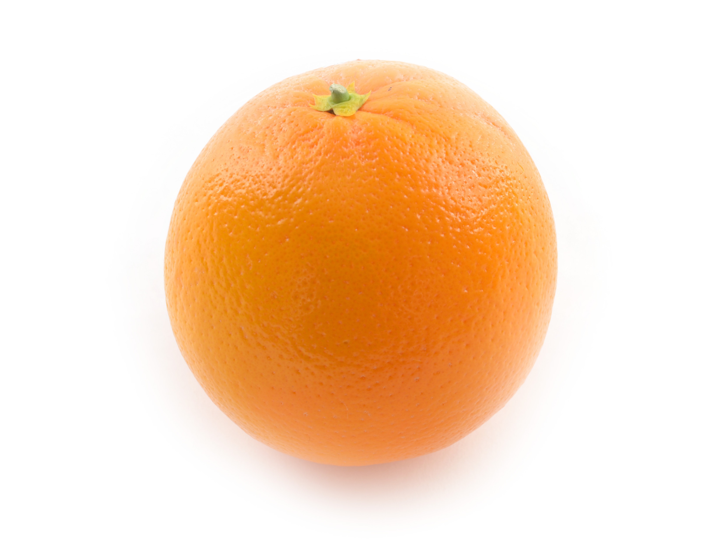
Méthodology : Random Forest
Let’s build a decision tree intuitively :
Elongation
Roughness
Color
Weight
d₁ | d₂ | d₃ | d₄

Slide 44
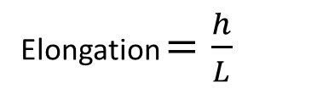
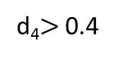
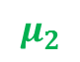

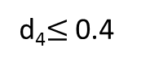
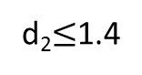
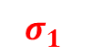

Méthodology : Random Forest
Let’s build a decision tree intuitively :
Elongation
Roughness
Color
Weight
Elongation: d₂
d₁ | d₂ | d₃ | d₄
d₂$≤$1.4
d₂>1.4
Roughness: d₄
d₄$≤$ 0.4
d₄$>$ 0.4
Elongation $=\frac{h}{L}$
$$μ_{1}$$
$$μ_{2}$$
1.4
$$σ_{1}$$
$$σ_{2}$$

Slide 45
Méthodology : Random Forest
Let’s build a decision tree intuitively :
Elongation
Roughness
Color
Weight
Elongation: d₂
d₁ | d₂ | d₃ | d₄
d₂$≤$1.4
d₂>1.4
Roughness: d₄
pear
d₄$≤$ 0.4
d₄$>$ 0.4
apple
orange

Slide 46
Méthodology : Random Forest
Let’s formalise our approach :
Messy sample
Decrease of disorder
Elongation
Roughness
Color
Weight
Shape: d₂
d₁ | d₂ | d₃ | d₄
d₂$≤$1.4
d₂>1.4
Less Messy
Ordered sample

Slide 47
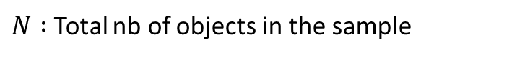
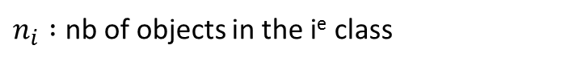

Méthodology : Random Forest
Let’s formalise our approach :
Messy sample
Decrease of disorder
Elongation
Roughness
Color
Weight
Shape: d₂
d₁ | d₂ | d₃ | d₄
d₂$≤$1.4
d₂>1.4
Less Messy
Ordered sample
Disorder Metric : Entropy H
$$H_{sample}=\sum_{i=1}^{nb classes}{−\frac{n_{i}}{N}log⁡(\frac{n_{i}}{N})}$$
$n_{i} :$ nb of objects in the i^{e} class
$N :$ Total nb of objects in the sample

Slide 48
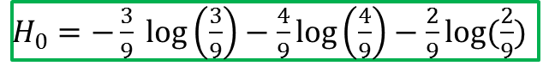
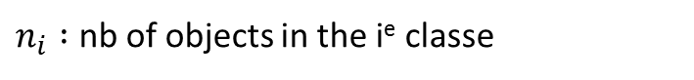
Méthodology : Random Forest
Let’s formalise our approach :
$H_{0}=−\frac{3}{9} log\left(\frac{3}{9}\right)−\frac{4}{9}log\left(\frac{4}{9}\right)−\frac{2}{9}log(\frac{2}{9})$
Elongation
Roughness
Color
Weight
Shape: d₂
d₁ | d₂ | d₃ | d₄
d₂$≤$1.4
d₂>1.4
Disorder Metric : Entropy H
$$H_{sample}=\sum_{i=1}^{nb classes}{−\frac{n_{i}}{N}log⁡(\frac{n_{i}}{N})}$$
$n_{i} :$ nb of objects in the i^{e} classe
$N :$ Total nb of objects in the sample

Slide 49
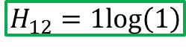
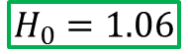
Méthodology : Random Forest
Let’s formalise our approach :
Elongation
Roughness
$$H_{0}=1.06$$
Color
Weight
Shape: d₂
d₁ | d₂ | d₃ | d₄
d₂$≤$1.4
d₂>1.4
$$H_{12}=1log\left(1\right)$$
Disorder Metric : Entropy H
$$H_{sample}=\sum_{i=1}^{nb classes}{−\frac{n_{i}}{N}log⁡(\frac{n_{i}}{N})}$$
$n_{i} :$ nb of objects in the i^{e} classe
$N :$ Total nb of objects in the sample

Slide 50
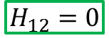
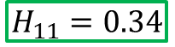
Méthodology : Random Forest
Let’s formalise our approach :
Elongation
Roughness
$$H_{0}=1.06$$
Color
Weight
Shape: d₂
d₁ | d₂ | d₃ | d₄
d₂$≤$1.4
d₂>1.4
$$H_{11}=0.34$$
$$H_{12}=0$$
Disorder Metric : Entropy H
$$H_{sample}=\sum_{i=1}^{nb classes}{−\frac{n_{i}}{N}log⁡(\frac{n_{i}}{N})}$$
$n_{i} :$ nb of objects in the i^{e} classe
$N :$ Total nb of objects in the sample

Slide 51
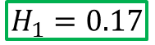
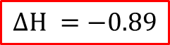
Méthodology : Random Forest
Let’s formalise our approach :
Elongation
Roughness
$$H_{0}=1.06$$
Color
Weight
Shape: d₂
d₁ | d₂ | d₃ | d₄
d₂$≤$1.4
d₂>1.4
$$H_{1}=0.17$$
$$ΔH =−0.89$$
➔ Disorder decrease
Disorder Metric : Entropy H
$$H_{sample}=\sum_{i=1}^{nb classes}{−\frac{n_{i}}{N}log⁡(\frac{n_{i}}{N})}$$
$n_{i} :$ nb of objects in the i^{e} classe
$N :$ Total nb of objects in the sample

Slide 52
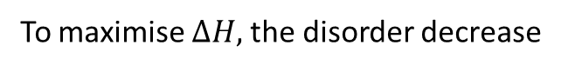
Méthodology : Random Forest
Let’s formalise our approach :
Elongation
Roughness
$$H_{0}=1.06$$
Color
Weight
Shape: d₂
d₁ | d₂ | d₃ | d₄
d₂$≤$1.4
d₂>1.4
$$H_{1}=0.17$$
$$ΔH =−0.89$$
➔ Disorder decrease
Algorithm to build a decision tree :
For each node in the tree
find the best feature d_{i}
and the best threshold T_{i}
To maximise $ΔH,$the disorder decrease

Slide 53
Méthodology : Random Forest
Up to now, we only built one tree.
A random Forest is a collection of trees…
Tree #1
Tree #2
Tree #3
… built on a Random subset of objects

Slide 54
Méthodology : Random Forest
Up to now, we only built one tree.
A random Forest is a collection of trees
d₁ | d₂ | d… | d₁₆
d₁₇ | d₁₈ | d… | d₃₅
d₃₆ | d₃₇ | d… | d₆₀
Tree #1
Tree #2
Tree #3
… built on a Random subset of objects…
and on a Random subset of features.

Slide 55
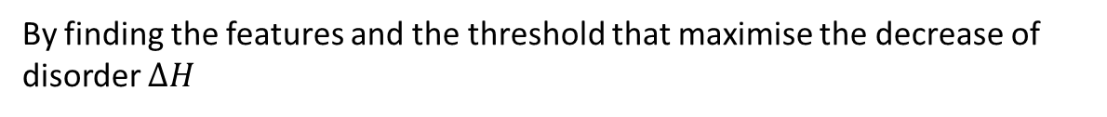
Méthodology : Random Forest
Elongation
Roughness
Color
Weight
Exemple d’arbre de décision
d₁ | d₂ | … | d_{F}
d₁ | d₂ | … | d_{F}
Si d₈₃<2.2
sinon
d₆₁₈<0.5
sinon
Si d₂₄₅<3.4
sinon
d₃₄₁<100
sinon
apple
pear
d₇₁₅<0.3
sinon
apple
apple
apple
apple
apple
pear
sain
pear
pear
pear
apple
pear
apple
How to automatically build a decision tree from the observation of examples ?
By finding the features and the threshold that maximise the decrease of disorder $ΔH$
This classifier is very interesting because : 1) it includes the feature selection step
2) it is robust against overfitting because each tree is learnt on a small part of the database

Slide 56
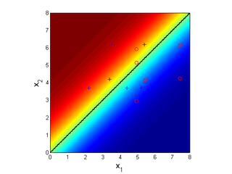
Méthodology : Random Forest
Feature 2
100%
Feature 2
Model
Probability of apple
Feature 1
Feature 1
0%

Slide 57

Méthodology : Random Forest
Feature 2
1
Model
Probabilité
Feature 1
0
Feature 2
Feature 1
➔ Building a model: is equivalent to finding the best probability function that fits the training set
is equivalent to a regression problem

Slide 58
Presentation Outline
1- Introduction
- Definition of Machine Learning
- A simple example
2- Methodology of Machine Learning
- General Methodology
- 2 Algorithms very popular : Random Forest
and Neural Network
3- Examples applied in Medicine : Disease Detection
4- Conclusion
- Synthesis
- Limits of Machine Learning

Slide 59




Methodology : Neural Network
You are all familiar with linear regression
y
2
f(x) = w x + b
1
0
1
$$Δ_{k}$$
w
b
0
0
0.5
1
x
Objective : Minimize $Err=\sum_{k }{{\left(y_{k}−f(x_{k})\right)}^{2}=\sum_{k }{Δ_{k}^{2}}}$

Slide 60
Methodology : Neural Network
You are all familiar with linear regression
y
2
f(x) = w x + b
1.5
0
1
w
b
0
0
0.5
1
x
Objective : Minimize $Err=\sum_{k }{{\left(y_{k}−f(x_{k})\right)}^{2}=\sum_{k }{Δ_{k}^{2}}}$

Slide 61




Methodology : Neural Network
You are all familiar with linear regression
y
2
f(x) = w x + b
2
0
1
w
b
0
0
0.5
1
x
Objective : Minimize $Err=\sum_{k }{{\left(y_{k}−f(x_{k})\right)}^{2}=\sum_{k }{Δ_{k}^{2}}}$
$\frac{∂Err}{∂w}$ = $2\sum_{k }{x_{k}(Δ_{k})}$
$\frac{∂Err}{∂b}$ = $2\sum_{k }{(Δ_{k})}$
1- You compute the derivatives of the error :
$$w ←w−\frac{∂Err}{∂w}$$
2 – You tune the parameters :
$$b ←b−\frac{∂Err}{∂b}$$

Slide 62
Methodology : Neural Network
You are all familiar with linear regression
y
2
f(x) = w x + b
1
0
1
w
b
0
0
0.5
1
x
Objective : Minimize $Err=\sum_{k }{{\left(y_{k}−f(x_{k})\right)}^{2}=\sum_{k }{Δ_{k}^{2}}}$
$\frac{∂Err}{∂w}$ = $2\sum_{k }{x_{k}(Δ_{k})}$
$\frac{∂Err}{∂b}$ = $2\sum_{k }{(Δ_{k})}$
1- You compute the derivatives of the error :
$$w ←w−\frac{∂Err}{∂w}$$
2 – You tune the parameters :
$$b ←b−\frac{∂Err}{∂b}$$

Slide 63
Methodology : Neural Network
You are all familiar with linear regression
y
2
f(x) = w x + b
1.5
0
1
w
b
0
0
0.5
1
x
Objective : Minimize $Err=\sum_{k }{{\left(y_{k}−f(x_{k})\right)}^{2}=\sum_{k }{Δ_{k}^{2}}}$
$\frac{∂Err}{∂w}$ = $2\sum_{k }{x_{k}(Δ_{k})}$
$\frac{∂Err}{∂b}$ = $2\sum_{k }{(Δ_{k})}$
1- You compute the derivatives of the error :
$$w ←w−\frac{∂Err}{∂w}$$
2 – You tune the parameters :
$$b ←b−\frac{∂Err}{∂b}$$

Slide 64
Methodology : Neural Network
You are all familiar with linear regression
y
2
f(x) = w x + b
1.7
0
1
w
b
0
0
0.5
1
x
x
Objective : Minimize $Err=\sum_{k }{{\left(y_{k}−f(x_{k})\right)}^{2}=\sum_{k }{Δ_{k}^{2}}}$
$\frac{∂Err}{∂w}$ = $2\sum_{k }{x_{k}(Δ_{k})}$
$\frac{∂Err}{∂b}$ = $2\sum_{k }{(Δ_{k})}$
1- You compute the derivatives of the error :
$$w ←w−\frac{∂Err}{∂w}$$
2 – You tune the parameters :
$$b ←b−\frac{∂Err}{∂b}$$

Slide 65

Methodology : Neural Network
You are all familiar with linear regression
y
2
f(x) = w x + b
2
0
1
w
b
0
0
0.5
1
x
Objective : Minimize $Err=\sum_{k }{{\left(y_{k}−f(x_{k})\right)}^{2}=\sum_{k }{Δ_{k}^{2}}}$
$\frac{∂Err}{∂w}$ = $2\sum_{k }{x_{k}(Δ_{k})}$
$\frac{∂Err}{∂b}$ = $2\sum_{k }{(Δ_{k})}$
1- You compute the derivatives of the error :
$$w ←w−\frac{∂Err}{∂w}$$
2 – You tune the parameters :
$$b ←b−\frac{∂Err}{∂b}$$

Slide 66
Methodology : Neural Network
You are all familiar with linear regression
y
2
f(x) = w x + b
2
0
1
w
b
0
0
0.5
1
1
x
Probabilité
Feature 1
Need of an adaptable model
Neural Network
0
Feature 2

Slide 67

Methodology : Neural Network
A neural network is a very complex function with lots of parameters
d₁
Color
Neural Network
d₂
Elongation
f
$$f(d_{1},d_{2},d_{3},…d_{f})$$
Weight
d₃
Probability of being an apple
Roughness
d…
w₁
w₂
w₃
w₄
w₅
……
d_{F}
w₆
w₇
w…
w₉₉₉
w₁₀₀₀

Slide 68
Methodology : Neural Network
d₁
Color
Neural Network
d₂
Elongation
f
$$f(d_{1},d_{2},d_{3},…d_{f})$$
Weight
d₃
Probability of being an apple
Roughness
d…
w₁
w₂
w₃
w₄
w₅
……
d_{F}
w₆
w₇
w…
w₉₉₉
w₁₀₀₀

Slide 69
Methodology : Neural Network
0.8
Neural Network
1.16
f
$$f(d_{1},d_{2},d_{3},…d_{f})$$
-7
Probability of being an apple
1.80
w₁
w₂
w₃
w₄
w₅
-0.5
w₆
w₇
w…
w₉₉₉
w₁₀₀₀

Slide 70

Methodology : Neural Network
0.8
Neural Network
1.16
f
$$f\left(d_{1},d_{2},d_{3},…d_{f}\right)=0.3$$
-7
Probability of being an apple
1.80
w₁
w₂
w₃
w₄
w₅
-0.5
w₆
w₇
w…
w₉₉₉
w₁₀₀₀

Slide 71

Methodology : Neural Network
0.8
Neural Network
$$Error=1−f\left(d_{1},…d_{f}\right)$$
= 0.7
1.16
f
$$f\left(d_{1},d_{2},d_{3},…d_{f}\right)=0.3$$
-7
Probability of being an apple
1.80
w₁
w₂
w₃
w₄
w₅
-0.5
w₆
w₇
w…
w₉₉₉
w₁₀₀₀

Slide 72



Methodology : Neural Network
0.8
Neural Network
$$Error=1−f\left(d_{1},…d_{f}\right)$$
= 0.7
1.16
f
$$f\left(d_{1},d_{2},d_{3},…d_{f}\right)=0.3$$
-7
Probability of being an apple
1.80
w₁
w₃
$$w_{1}←w_{1}−\frac{∂Error}{∂w_{1}}$$
w₂
w₄
w₅
$$w_{2}←w_{2}−\frac{∂Error}{∂w_{2}}$$
-0.5
w₆
w₇
w…
w₉₉₉
w₁₀₀₀
$$w_{1000}←w_{1000}−\frac{∂Error}{∂w_{1000}}$$

Slide 73
Methodology : Neural Network
d₁
d₂
N₁
N₃
$$f(d_{1},d_{2},d_{3},…d_{f})$$
N₅
d₃
Probability of being an apple
N₂
N₄
d…
d_{F}

Slide 74








Methodology : Neural Network
$$N_{1}(y)=\frac{1}{1+exp⁡(−(y−T))}$$
1
d₁
➔ $y=w_{1}d_{1}+w_{2}d_{2}+…w_{N} d_{N}$
➔$N_{1}(y)=\frac{1}{1+exp⁡(−(y−T))}$
$$w_{1}$$
0
d₂
$$w_{2}$$
T
y
N₁
N₃
$$f(d_{1},d_{2},d_{3},…d_{f})$$
N₅
d₃
$$w_{3}$$
Probability of being an apple
N₂
N₄
$$w_{4}$$
d…
$$w_{5}$$
d_{F}

Slide 75
Methodology : Neural Network
d₁
d₂
N₁
y₁
N₃
$$f(d_{1},d_{2},d_{3},…d_{f})$$
N₅
d₃
Probability of being an apple
N₂
N₄
d…
Exactly the same as N₁ but with different parameters
d_{F}
w₁…
w_{F}
T

Slide 76
Methodology : Neural Network
N₁
y₁
N₃
y₁
$$f(d_{1},d_{2},d_{3},…d_{f})$$
N₅
Probability of being an apple
N₂
y₂
N₄
y₂

Slide 77
Methodology : Neural Network
N₁
N₃
y₃
$$f(d_{1},d_{2},d_{3},…d_{f})$$
N₅
Probability of being an apple
N₂
N₄
y₄

Slide 78
Methodology : Neural Network
N₁
N₃
$$f(d_{1},d_{2},d_{3},…d_{f})$$
N₅
y₅
Probability of being an apple
N₂
N₄

Slide 79

Methodology : Neural Network
N₁
N₃
$$f(d_{1},d_{2},d_{3},…d_{f})$$
N₅
0.3
Probability of being an apple
N₂
N₄
$$Error=1−f\left(d1,…\right)$$
$$w_{1}←w_{1}−\frac{∂Error}{∂w_{1}}$$
$$w_{2}←w_{2}−\frac{∂Error}{∂w_{2}}$$
$$w_{1000}←w_{1000}−\frac{∂Error}{∂w_{1000}}$$

Slide 80
Methodology : Neural Network
0.8
1.16
N₁
N₃
$$f(d_{1},d_{2},d_{3},…d_{f})$$
N₅
-7
0.3
Probability of being an apple
N₂
N₄
1.80
-0.5

Slide 81

Methodology : Neural Network
0.8
1.16
N₁
N₃
$$f(d_{1},d_{2},d_{3},…d_{f})$$
N₅
-7
$$Δ=1 −0.3$$
Probability of being an apple
N₂
N₄
1.80
-0.5

Slide 82

Methodology : Neural Network
0.8
1.16
N₁
N₃
$$f(d_{1},d_{2},d_{3},…d_{f})$$
N₅
-7
$$Δ=0.7$$
Probability of being an apple
N₂
N₄
1.80
-0.5

Slide 83

Methodology : Neural Network
0.8
1.16
N₁
N₃
W_{i}
$$f(d_{1},d_{2},d_{3},…d_{f})$$
N₅
-7
$$Δ=0.7$$
Probability of being an apple
N₂
N₄
W_{j}
1.80
-0.5

Slide 84

Methodology : Neural Network
0.8
1.16
N₁
N₃
W_{i}
$$f(d_{1},d_{2},d_{3},…d_{f})$$
N₅
-7
$$Δ=0.7$$
Probability of being an apple
N₂
N₄
W_{j}
1.80
-0.5

Slide 85


Methodology : Neural Network
0.8
1.16
N₁
N₃
W_{i}
$$f(d_{1},d_{2},d_{3},…d_{f})$$
N₅
-7
$$Δ=0.7$$
Probability of being an apple
W_{j}
$$Δ=0.7$$
N₂
N₄
1.80
-0.5

Slide 86


Methodology : Neural Network
0.8
1.16
N₁
N₃
W_{i}
$$f(d_{1},d_{2},d_{3},…d_{f})$$
$Δ_{3}$=$w_{i}Δ$
N₅
-7
$$Δ=0.7$$
Probability of being an apple
W_{j}
$$Δ=0.7$$
N₂
N₄
1.80
$$Δ_{4}=w_{j}Δ$$
-0.5

Slide 87






Methodology : Neural Network
0.8
1.16
N₁
N₃
$$Δ_{3}$$
$$Δ_{3}$$
W_{i}
$$f(d_{1},d_{2},d_{3},…d_{f})$$
$$Δ_{3}\text{=}w_{i}Δ$$
N₅
-7
$$Δ=0.7$$
Probability of being an apple
$$Δ_{4}$$
W_{j}
$$Δ=0.7$$
N₂
$$Δ_{4}$$
N₄
1.80
$$Δ_{4}=w_{j}Δ$$
-0.5

Slide 88




Methodology : Neural Network
0.8
1.16
N₁
N₃
W_{i}
$$f(d_{1},d_{2},d_{3},…d_{f})$$
$$Δ_{1}$$
$$Δ_{3}$$
N₅
-7
$$Δ=0.7$$
Probability of being an apple
W_{j}
$$Δ=0.7$$
N₂
N₄
1.80
$$Δ_{2}$$
$$Δ_{4}$$
-0.5

Slide 89





Methodology : Neural Network
0.8
1.16
N₁
N₃
W_{i}
$$f(d_{1},d_{2},d_{3},…d_{f})$$
$$Δ_{1}$$
$$Δ_{3}$$
N₅
-7
$$Δ_{5}$$
Probability of being an apple
N₂
N₄
W_{j}
$w_{i}←$ $w_{i}−α_{i}Δ_{5}$
1.80
$$Δ_{2}$$
$$Δ_{4}$$
$$w_{j}←w_{j}−α_{i}Δ_{5}$$
$w_{l}←$ $w_{l}−α_{l}Δ_{4}$
$$w_{1}←w_{1}−\frac{∂Error}{∂w_{1}}$$
$w_{k}←$ $w_{k}−α_{k}Δ_{4}$
$$w_{2}←w_{2}−\frac{∂Error}{∂w_{2}}$$
-0.5
$$w_{1000}←w_{1000}−\frac{∂Error}{∂w_{1000}}$$

Slide 90

















Methodology : Neural Network
Summary Neural Network :
1- A Neural network is a probability function $f\left(d_{1},d_{2},…,d_{F}\right)$ aimed at fitting the training set
d₁
$$f$$
1
d₂
$$f\left(d_{1},d_{2},…,d_{F}\right)$$
Probabilité
d…
Feature 1
d_{F}
0
Feature 2
2- The function $f,$is a combination of subfunctions called neurons : $n_{w_{1},w_{2},…,w_{L}}$
3- Each parameter $w_{i}$ is tuned by “backpropagating” the error of each object of the training set.
Backpropagation
$$Δ_{4}$$
$$Δ_{8}$$
$$Δ_{1}$$
$$Δ_{5}$$
$$Δ_{9}$$
$$Δ_{2}$$
$$Δ$$
$$Δ$$
: Error
$w_{i}←$ $w_{i}−α_{i}Δ_{j}$
$$Δ_{6}$$
$$Δ_{10}$$
$$Δ_{3}$$
$$Δ_{7}$$
$$Δ_{11}$$
Training set
Propagation

Slide 91
Methodology : Neural Network
Summary Neural Network :
1- A Neural network is a probability function $f\left(d_{1},d_{2},…,d_{F}\right)$ aimed at fitting the training set
d₁
$$f$$
1
d₂
$$f\left(d_{1},d_{2},…,d_{F}\right)$$
Probabilité
d…
Feature 1
d_{F}
0
Feature 2
2- The function $f,$is a combination of subfunctions called neurons : $N_{w_{1},w_{2},…,w_{L}}$
3- Each parameter $w_{i}$ is tuned by “backpropagating” the error of each object of the training set.
Backpropagation
$$Δ$$
: Error
$w_{i}←$ $w_{i}−α_{i}Δ_{j}$
Training set
Propagation

Slide 92
Methodology : Neural Network
Summary Neural Network :
1- A Neural network is a probability function $f\left(d_{1},d_{2},…,d_{F}\right)$ aimed at fitting the training set
d₁
$$f$$
1
d₂
$$f\left(d_{1},d_{2},…,d_{F}\right)$$
Probabilité
d…
Feature 1
d_{F}
0
Feature 2
2- The function $f,$is a combination of subfunctions called neurons : $N_{w_{1},w_{2},…,w_{L}}$
3- Each parameter $w_{i}$ is tuned by “backpropagating” the error of each object of the training set.
Backpropagation
$$Δ$$
: Error
$w_{i}←$ $w_{i}−α_{i}Δ_{j}$
Training set
Propagation

Slide 93
Methodology : Summary
2 Steps :
Building of a representation
Building of a model
1-Feature Extraction
2-Feature Selection
1-Training a model
2-Testing
Random Forest
Neural Network
Shape
Model
Color
2D representation of apple and pears

Slide 94
Presentation Outline
1- Introduction
- Definition of Machine Learning
- A simple example
2- Methodology of Machine Learning
- General Methodology
- 2 Algorithms very popular : Random Forest
and Neural Network
3- Examples applied in Medicine : Disease Detection
4- Conclusion
- Synthesis
- Limits of Machine Learning

Slide 95

Examples of machine learning algorithm : Disease Detection
-IDx-DR : first machine learning tool approved by the FDA (April 2018)
Detect an ocular disease : Diabetic Retinopathy
Can be very useful in region lacking of ophthalmologist

Slide 96


Examples of machine learning algorithm : Disease Detection
For each pixel in the image :
Extract some features : intensity, gradient, local mean etc…
Train a classifier (here, neural network) to classify each pixel as belonging or not to a lesion
As we use a neural network, the algorithm is said to be a deep learning algorithm

Slide 97


Examples of machine learning algorithm : Disease Detection
- (August 2018)
Delineation of the different layers of the eye
Diagnosis and referral suggestion

Slide 98

Examples of machine learning algorithm : Disease Detection
- (August 2018)
Delineation of the different layers of the eye
Diagnosis and referral suggestion
Performance on an independent test set of n = 997 patients (252 urgent, 230 semi-urgent, 266 routine, 249 observation only).

Slide 99
Presentation Outline
1- Introduction
- Definition of Machine Learning
- A simple example
2- Methodology of Machine Learning
- General Methodology
- 2 Algorithms very popular : Random Forest
and Neural Network
3- Examples applied in Medicine : Disease Detection
4- Conclusion
- Synthesis
- Limits of Machine Learning

Slide 100

Conclusion
Methodology :
Building of a representation
Building of a model
1-Feature Extraction
2-Feature Selection
1-Training a model
2-Testing
Example of classifier :
-Random Forest
-Neural Network = Deep learning
All algorithm capable of mimicking the human behaviour

Slide 101

Conclusion
Elongation
$$\frac{h}{L}$$
2
h
L
1
1
0
Color
PEAR BOX
APPLE BOX

Slide 102
Conclusion
Methodology :
Building of a representation
Building of a model
1-Feature Extraction
2-Feature Selection
1-Training a model
2-Testing
Example of classifier :
-Random Forest
-Neural Network = Deep learning
All algorithm capable of mimicking the human behaviour
Algorithm that learn a model from the observation of examples
Machine learning algorithm that use Neural Network

Slide 103
Conclusion
Methodology :
Building of a representation
Building of a model
1-Feature Extraction
2-Feature Selection
1-Training a model
2-Testing
Example of classifier :
-Random Forest
-Neural Network = Deep learning
All algorithm capable of mimicking the human behaviour
Algorithm that learn a model from the observation of examples
Machine learning algorithm that use Neural Network

Slide 104

Conclusion
Limits of Machine Learning :
They are often black box system that are NOT interpretable
d₁
$$f$$
d₂
$$f\left(d_{1},d_{2},…,d_{F}\right)$$
d…
d_{F}
We know deep learning work, but we still don’t know why. So how can we be confident in such algorithms…
System easy to fool

Slide 105

Conclusion
Limits of Machine Learning :
- We need a lot of labellised data. (ex: Need ophthalmologist to delineate images ➔ expensive)
- Google’s captcha are used to do annotation
Problem : A few companies (Google, Amazon, Facebook etc.)
have a huge database.

